Slide 1
Graduate School in Psychology
Template slides for teaching undergraduates

Slide 2
faculty: How to use this material
Consider hosting a workshop at your home institution about graduate programs in Psychology.
  Many undergraduate students, especially first-generation students, are unaware of the various careers in psychology one can pursue with an advanced degrees.
  Students are also generally unaware of the different types of graduate programs and degrees.
  Finally, many do not know that some programs, like Ph.D. granting programs, are generally fully-funded.
  This is a platform to recruit more students to personality psychology!
Alternatively, post these slides to your course website.
  Interested students can view at their leisure.

Slide 3
Students: How to use this material
The resources we provide here are focused on graduate school in Psychology within the United States.
Some information may be applicable to your situation depending on the country you wish to pursue graduate studies in.
  e.g., programs in Canada may be more like those in the U.S. than to programs in Europe.
Use this material as a set of guidelines, rather than a set of hard and fast rules.
It’s important to factor in your specific circumstances, identities, and goals when deciding on if and how to pursue graduate studies.
We hope you can use these resources in conversation with your peers, professors, and other mentors!

Slide 4
I Want to Learn More About…
Why I should consider graduate school
How to apply to graduate school
Financing my graduate education

Slide 5
Why go to graduate school?

Slide 6
What Can I Do With a Background in Personality Science?
Personality psychologists can be found in many places. You can find us...
Treating patients with personality disorders.
Developing tests to help high school students identify potential careers.
Analyzing data for the US government and the private sector.
Improving people’s experiences with social media.
Teaching undergraduate and graduate students.

Slide 7
Why go to graduate school?
Training in specific skills
  Therapy
  Research design, data analysis
  Teaching
Preparation for licensing exams
  Necessary for clinical work
Networking and professional development
  Learn more about the career(s) you are interested in and make contacts with people in those careers

Slide 8
Should I apply to graduate programs?
Consider your career goals.
A good career goal describes your values and preferences, not a specific job.
“I want to work with children struggling with mental health problems,” not, “I want to be a psychologist.”
Why?
You’ll miss out on lots of jobs that might be a better fit for you.
It’s possible you don’t have a great sense of what a specific job entails.

Slide 9
What’s Your Career Goal?
Therapy, working with clients
Consider pursuing degrees in Counseling, School, or Community Psychology, or a degree in Social Work or Education.
  You’ll most likely want to look for Master’s programs.
  These degrees vary in cost, but the programs are relatively short (2-3 year). The end of this presentation discusses financing your graduate education.
Psychiatrists work at the intersection of medicine and therapy.
  This requires a medical degree, meaning medical school.
  The degree is generally more expensive, and it takes longer to complete, but psychiatrists also tend to have higher incomes.
Mitch Prinstein has some good advice about these routes.

Slide 10
What’s Your Career Goal?
Research, studying people, working with data
You’re likely a good fit for a Ph.D., which is a research-oriented degree.
  Ph.D. programs are generally fully-funded and many come with a (small) stipend, so students do not need to take on additional work while pursuing their degree.
A few words of caution:
  Doing research is different from learning. You may enjoy learning but not doing research.
  For those interested in becoming professors, know that the academic job market has been getting worse over recent decades.
  Not every program or advisor will be equipped to help you get a job outside of academia
You’ll want to narrow down your focus of study before identifying potential advisors and programs.

Slide 11
What’s your career goal?
Being a professor.
What draws you to this career?
  What aspects of scientific study are most interesting to you
How well do you understand the day-to-day life of your professors?
  Do you think you would enjoy traveling, grant writing, mentoring, teaching, data analysis, editing, public speaking, writing, and administrative work?
Are you willing / able to make several moves over your career?
What does good work-life balance look like for you?
For those interested in science, MyIDP can help you clarify your values and goals and match you with appropriate jobs.

Slide 12
What is graduate school like?
For research-focused programs (Ph.D and some Masters):
Training in research and data science
Most work is outside the classroom
Apprenticeship model
Graduate student is more like an entry-level position in a career, rather than being a student
For clinical-focused programs (Masters and Psy.D.):
Coursework is more important
Experience gained through internships and practicums
This presentation is mainly focused on research-focused programs!

Slide 13
Applying to Graduate School
Source:Dr Rodica Damian, University of Houston

Slide 14
Start planning early
2-3 years before applying (~ sophomore year)
Build a strong GPA
Join a lab
Build professional relationships with Professors
1-2 years before applying (~ junior year)
Gain research experience
Research graduate programs
Take GRE
Summer and fall of application season (~ senior year)
Ask for letters of recommendation early in the year
Submit applications

Slide 15
For International Students
You can continue your F-1 status and get one year of optional practical training.
You can use the practical training either before or after grad school but choose wisely.
Consult with your international students’ office to get the latest advice because laws change.
After you get accepted to a grad program, contact the international student office at that school for more information.
Most graduate financial aid is unrestricted--international students are eligible.

Slide 16

Select Programs
Select schools
  Department, not university rankings matter
  Select about 15-20 potential programs based on their match with your academic record, research experience, research interests, and career goals
For PhDs, the faculty mentor is one of the most important things to consider.
  Most departments use an “apprenticeship model”
  Your mentor will be responsible for most of your training, research productivity, and professional development.
  Good fit (both in terms of research and personality) is essential.

Slide 17
Select Programs: Finding an advisor at the prospective school
Identify professors who share your research interests
  Check their websites, and look to see if they mention their mentoring philosophies and/or lab values
  Read journal articles they authored
Identify programs where your research interests are compatible with 2-3 potential mentors, which will boost your likelihood of attracting interest from at least one of them.
Contact potential mentors to verify they are accepting a new student during the next application cycle.
Narrow down your list with the goal of applying to around 8-12 schools. Depending on your resources, you may want to apply to a range of schools (e.g., less selective → highly selective schools).

Slide 18
Application Requirements
GPA*
GRE Tests**
Research Experience
CV/ Resume
Personal Statement
Recommendation Letters
The Interview
Even if you do not meet GPA requirements for the program, it is worth reaching out to the potential advisor to see if this is a hard requirement.
The GRE is not always a requirement for applications, so be sure to check the specific program requirement.

Slide 19

GPA
You will need to send official transcripts to each school you apply to.
The better your grades, the better your chances, but exceptions apply, and you do not need perfect grades.
Other aspects of your package may be more important.
Optional steps to make your application stellar:
  Good grades in methods and statistics courses.
  Expertise in open source statistical programs like R. There are excellent and free resources online for teaching yourself this program.

Slide 20
Graduate Record Examination (GRE)
Take the exam the summer before you apply.
Don’t wait until the last minute. Scores can take up to 6 weeks to process.
Scores are good for 5 years. Take it even if you’re considering waiting a year or two to apply to graduate school:
Keep the price tag in mind:
The exam costs $205 to take.
Sending official scores to schools often includes additional fees.
Look into the GRE Fee Reduction Program for financial assistance.
Ask potential programs if they can accept unofficial scores -- some do and only require your official scores if you’ve been accepted to the program.
Don’t forget to prepare.
The GRE offers a free practice test.
Test-prep books (see Kaplan and ETS) are excellent, range from $30-$60.
Look online for free vocabulary flash cards.
Some programs also require subject GREs.
These are additional exams specific to subject matter, like Psychology. Make sure you know whether your program requires this and factor in the cost of taking and preparing for this exam as well.

Slide 21

Prior Research Experience Is Highly Valued
Work in the research labs at your university
  You can contact professors to ask about available positions.
  Some spots are paid but most are voluntary or for course credit. Ask about work-study options.
  When working in research labs, show initiative, get involved with research projects.
  You can also work over the summer or work full-time as a research assistant between undergraduate and graduate school.
Write a senior honors thesis
  Check the Psychology department website of your university to see the requirements and timeline.

Slide 22
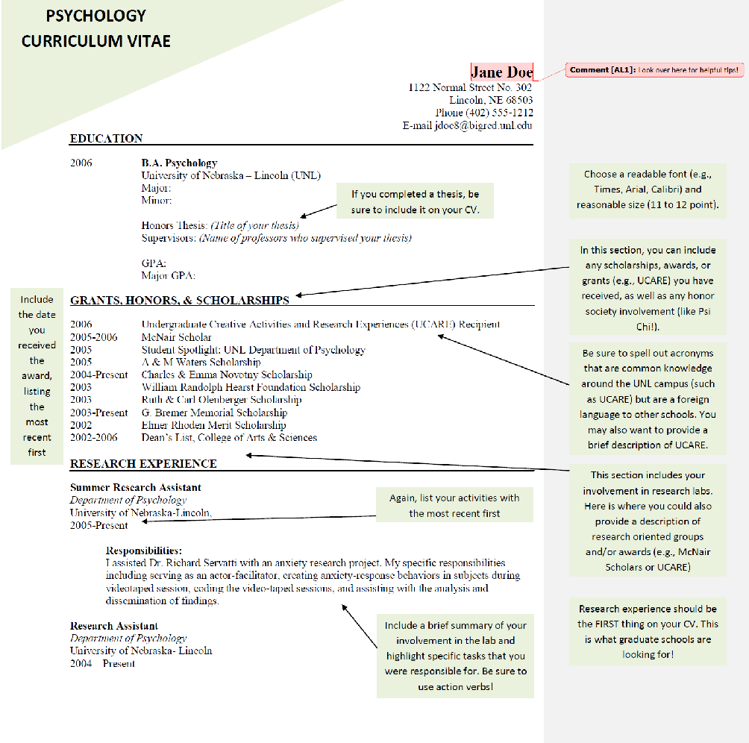
CV

Slide 23
Personal Statement
Read each school’s prompt carefully. Tailor the statement to the program and advisor you’re applying to.
Use a worksheet to prepare your statement. Some examples:
  UCAS Personal Statement Worksheet
  Amherst College - Writing Your Personal Statement
  Old Dominion - Writing an Effective Personal Statement
  Consider using a book as a guide to crafting the best possible statement.
    Example: Donald Asher’s Graduate Admissions Essays

Slide 24
Recommendation Letters
If it’s possible, consider how each letter writer can offer different insights into your abilities, talents, and who you are as a person
You will need at least 3 letters from university professors
  Select people who know you (ideally you have worked in their research labs/ clinical practice for at least 2 months)
When to ask
  The sooner the better
  Send gentle reminder email to check in 2 weeks before each deadline
What to include when asking for a recommendation
  Prepare a folder of all your info for each writer
  Resume/CV, Transcript/Courses taken with grades
  Personal Statement (so they can match their letter with your interests/goals as much as possible)
  Spreadsheet of all the schools, deadlines, what to include, how to submit (email, online, return to student, etc.)
  Pre-addressed/Stamped envelopes for those that need to be snail mailed (hopefully none will be needed, very rare)

Slide 25
Interviews
If your written application is successful, you may be invited to an interview.
May be after you’ve received an offer.
May be just the next step in the application process.
Interviews are always 2-way streets: this is an opportunity for you to decide whether the program is right for you.

Slide 26
Interviews: Put your best foot forward
Pay attention to your body language / eye contact.
Every interaction is important! Showing respect towards every person you meet can go a long way.
Bring questions and always be prepared to ask them, but don’t forget to take turns in any conversation
Know the answers to questions about your interests, motivations, goals, abilities and experience
Try to know who you will be meeting with ahead of time.
  Spend some time doing a ‘deep dive’ on the program prior to your interviews.
Google interview tips & sample interview questions
Dress professionally, but make sure you feel comfortable spending the entire day in the outfit you choose
Take bathroom breaks when they are offered, even if it’s just to have some down time to collect your thoughts
Be yourself! Being a little nervous is okay and expected. It shows that you’re excited about the possibility of attending the program.

Slide 27
Interviews: Use the opportunity to learn more
Learn everything you can about the success and well-being of current students.
  Ask current students what they like and dislike, what issues have come up in the past, how those issues have been resolved.
  How long do students typically spend in the program? Are students successful at finding jobs after graduation? In what kinds of careers?
  What opportunities for training or development are unique to this program?
Keep your well-being in mind.
  Will you be comfortable living in this city for 2-6 years? Will you feel safe?
  It’s ok to consider constraints on location, especially if you’re responsible for other people.

Slide 28
Acceptance
If you are accepted:
  How long do I have to decide?
    Standard deadline: April 15
  Notify programs where you interviewed of offers from other programs.
  Do not feel pressured to accept an offer early if you may have other options; do not accept any offer immediately.
    But be courteous… once you know your decision, let programs know so they can reach out to their waitlist.
If you are not accepted:
  Reassess
    Were you a good fit for these programs? If no, why not?
  Consider reaching out to interviewers for feedback.
  Gain more research experience; consider a Master’s degree.
Notes:
Once the program accepts you, you have until April 15th to tell them your decision (whether you accept/will join their program, or not).
Be courteous… once you know your decision for sure, consider letting them know soon. Other people may be waitlisted. It is not required, but more like being a good citizen.
If waitlisted, they should tell you what position/number you are on the waitlist. If you’re near the top, there’s a pretty good chance you could still be accepted later (if the first round of people they accepted have declined/decided to go elsewhere). But if the others don’t get back to them until April 15th, it may be after April 15th that you get accepted. Which would be after you have to tell other schools of your decision if you’re accepted there. So you have to hedge your bets.
If rejected – try not to get too discouraged! So much goes into the “FIT”
Could consider doing Master’s program first, then later do PhD program

Slide 29

Financing Your
Graduate Education
Source: Dr Christiane Spitzmueller, University of Houston

Slide 30
Basics
PhD programs tend to be 100% funded
  But salaries (called stipends) and other benefits (e.g., healthcare) vary across schools
MA programs tend to be unfunded--you have to fund yourself
  But there are some exceptions, e.g., College of William and Mary, Wake Forest, Villanova
  And see following slides for ways to fund yourself
Look carefully at each school’s website

Slide 31
Loans
Federal Graduate can help cover the cost of higher education. Two types of federal loans (along with private loan options)
  Direct Unsubsidized Loan
    Graduate students are NOT eligible for subsidized loan (US Dept. of Education pays interest while you are in school at least half time).
    No need to demonstrate financial need
    Interest will accrue (Fixed rate is 6.6%)
    Limit on annual and cumulative loan amount
  Direct PLUS Loans
    Loans to eligible graduate students through schools participating in the Direct Loan Program
    Must not have an adverse credit history
    A parent can cosign for the loan
    Fixed interest rate is 7.6%
    You can borrow up to cost of attendance
Private loans through lending institutions (e.g., banks and credit unions)
https://studentaid.ed.gov/sa/types/loans
https://mastersinpsychologyguide.com/articles/financial-assistance/
Notes:
Graduate students have plenty of loan options once they arrive to grad school.
The first is the Direct Unsubsidized Loan. Graduate students are not eligible for subsidized loans in which the government pays your interest while you attend school at least ½ time.
There is no need to show that you need financial assistance
No need to pay until after your grace period ends (usually 6 months post-graduation), but your interest accrues throughout.
However, there are limits to how much you can borrow each year and cumulatively.
The next is a Direct Plus Loan
This loan depends on your credit score/history
Allows a parent to cosign for the loan
There are also private loans that you can seek through lending institutions, but their interest rates and repayment plans will vary. Often not the greatest choice since they usually offer higher interest rates.
https://studentaid.ed.gov/sa/types/loans

Slide 32
Loan Repayment Options
Psychologists can earn loan forgiveness (for Direct Loans only) under the following qualifications:
  You are required to make 120 payments, which must be on time, according to the schedule set out in your Direct Loans.
  You must make those payments under a repayment plan that qualifies for student loan forgiveness.
  You must work full-time at a qualifying public service institution at the time that you make all your payments
National Health Service Corps Loan repayment Plan
  Administered by the Bureau of Health Workforce (BHW) in the Health Resources and Services Administration (HRSA) of the U.S. Dept. of Health and Human Services (HHS)
  Serve two full years at a qualifying practice, in which case the NHSC will pay up to $50,000 toward your student loans, or
  Serve two half-time years at a qualifying practice, in which case the NHSC will pay up to $25,000 toward your student loans
https://mastersinpsychologyguide.com/articles/financial-assistance/
Notes:
But we can’t forget about paying back our loans! Thankfully, there are some options that are unique to psychologists. Given that some of you may be interested in joining the public health force, you are eligible for some loan forgiveness or modified repayment plans.
https://nhsc.hrsa.gov/downloads/loan-repayment/nhsc-LRP-application-program-guidance.pdf

Slide 33
Scholarships
Click here to learn more about scholarships for:
Underrepresented minorities
Women
LGBTQ persons
Veterans
Numerous scholarships you can apply for that offer financial support that do not need to be paid back
Scholarships through Psi Chi
  Allyn and Bacon Award for empirical research paper
  (Prizes of $1,000, $650, and $350)
  Diversity Article awards on topics of diversity issues
  (Four awards of $300)
Irwin L. Goldstein Scholarship and the Benjamin Schneider Scholarship
  For minority doctoral student in I-O psychology
APF Graduate Student Scholarships
  General scholarship for graduate students in psychology
George C. Thornton, III Graduate Scholarship
  Supports doctoral student in I/O psychology
Scott and Paul Pearsall Grant
  Supports graduate students who seek to increase understanding of psychological pain and stigma experience by adults with visible physical disabilities
Notes:
I am going to just point a few that are available, but it worthwhile doing a search and see if there is anything else that you think fits. The idea is to apply to as many as you can. Some applications are short and sweet and worth the effort, others may take more time but you may reap bigger awards.
While no list is exhaustive, here is a snapshot of a few scholarships that may be applicable to you.
https://www.apa.org/about/awards/index

Slide 34
Pre- Application:
Programs That Offer Financial Support
National Programs That Offer GRE Fee Reductions and Grad Program Assistance:
Gates Millennium Scholars Program
  Gates Millennium Scholars program: Founded by Bill Gates foundation
  Scholarship program for incoming freshman students of color entering college, however, if you are one of these recipients and continue onto grad school, you are eligible for a GRE fee reduction and Gates Millennium Fellowship in a graduate degree program
Veteran’s Affairs
  For past and present Servicemembers, and their families
Notes:
The Gates Millenium Scholars Foundation Program begins for HS seniors, but if you applied and are one of the receipients prior to entering your freshman college year, you are eligible for financial assistance during the graduate school application process and eligible for a fellowship as well.
Veteran’s Affairs offers several grants, scholarships, and assistance for undergraduate and graduate education for Servicemembers and their famiies.

Slide 35
I Have Offers!
What Should I Consider, Financially?
Timing of first payment?
  Some institutions may not pay you until you have been in school for 1-2 months.
Health insurance
  Some institutions may allow you to choose a special faculty insurance or may offer special graduate insurance rates.
Plan on getting a Master’s degree first?
  Some students decide this is a great option to boost their CV and experience.
  Ask potential PhD and PsyD programs if they will honor courses taken elsewhere.
  Some institutions will allow undergraduates to take graduate level courses prior to enrolling in the MA program.
Can I work while enrolled?
  Most PhD and PsyD programs disallow working during enrollment due to the workload.
  Some Master’s programs may be ok with this, but careful consideration of your personal timeline, finances, and workload must inform this decision.

Slide 36
Thank you for Watching/
Reading!
Thank you to Drs. Candice Alfano, Rodica Damian, and Christiane Spitzmueller for allowing us to adapt their slides.
These slides were created, edited, and formatted by Drs. Robert Latzman, Chris Martin, Nicole Lawless DesJardins, Sara Weston, and Joanne Chung.

Slide 37
Scholarships for Underrepresented Minorities
The National Association of School Psychologists – Education and Research Trust
American Association of University Women International Fellowships
  For women who are not US citizens or permanent residents
APA Mental Health and Substance Abuse Services Fellowship
  For those pursuing doctoral degrees in various mental health services areas to promote culturally competent mental health and substance abuse services
Filipino-American Psychology Scholarship
  To increase the number of Filipino-American professors, researchers, and academics in the field of psychology
Mental Health Dissertation Research Grant to Increase Diversity
  qualified doctoral candidates from underrepresented groups, with disabilities or from disadvantaged backgrounds
Zeta Phi Beta Sorority General Graduate Fellowships
  For African-American graduate women who are working on professional degrees, master's degrees, doctoral, or post-doctoral studies.
Notes:
These are just some that are directed towards ethnic minority students who are seeking to continue their education or current graduate students who need financial support for research and travel
https://www.nasponline.org/membership-and-community/awards-scholarships-and-grants/minority-scholarship-program
https://www.apa.org/about/awards/index

Slide 38
Scholarships For Women
Carol Williams-Nickelson Award for Women’s Leadership
  For women currently pursuing a doctorate in psychology with research focused on women’s issues
Career Advancement Scholarship
  Variable scholarship awarded to undergraduate women currently studying psychology
Nancy B. Forest and L. Michael Honaker Master’s Grant for Research in Psychology
  Open to women conducting Master’s thesis research in psychology
Woodrow Wilson Dissertation Fellowship in Women’s Studies
Pioneer Graduate Student Award
  For Asian Pacific feminist graduate student who seeks to develop and advance feminist understanding of the psychology of Asian Pacific American women.
Psychology of Black Graduate Student Women Award
American Association of University Women Career Development Grant
  Support women who are preparing to attain a Master’s degree
Notes:
These are just some that are directed towards ethnic minority students who are seeking to continue their education or current graduate students who need financial support for research and travel
https://www.nasponline.org/membership-and-community/awards-scholarships-and-grants/minority-scholarship-program
https://www.apa.org/about/awards/index

Slide 39
Scholarships For LGBTQ Persons
Point Foundation LGBT Scholarships
  Point Foundation provides scholarships, mentorship, leadership training and hope for undergraduate and graduate students of merit who have been marginalized due to sexual orientation, gender identity or gender expression.
Bisexual Foundation Scholarship Award
  Select graduate students who advance research on the psychology of bisexuality
Malyon Smith Scholarship Research Award
  Graduate students who advance research on sexual orientation and gender identity
Transgender Research Award
  Open to anyone conducting psychological research using trans participants or studying issues affecting trans people and communities.
Roy Scriver Memorial Research Grants
  For empirical and applied research focused on lesbian, gay and bisexual family psychology and lesbian, gay and bisexual and transgender family therapy
Notes:
These are some scholarship opportunities for students who are interested in LGBTQ studies. These scholarships help with research and travel assistance

Slide 40
Scholarships For Veterans
Post 9/11 GI Bill
  Helps with tuition and fees, housing, books and supplies, money to help move
Fry Scholarship
  If a parent or spouse was an active-duty Servicemember who died in the line of duty on or after 9/11. Includes money for tuition, housing, books and supplies
Survivors’ and Dependents’ Educational Assistance Program
  For children or spouses of a Veteran or Servicemember who has died, is captured or missing, or has disabilities.
Veterans United Foundation Scholarship
Army Women’s Foundation Legacy Scholarship program
Navy Wives Club of America (NWCA) Mary Paolizzi Member’s Scholarship
  NWCA members who are college graduates or undergraduate seniors who expect to enter graduate school in the upcoming year
Iraq and Afghanistan Service Grant
  If parent or guardian died as result of military service in Iraq or Afghanistan
Notes:
These are some scholarship opportunities for students who are interested in LGBTQ studies. These scholarships help with research and travel assistance

Slide 41
Links and Resources
GRE Fees:
https://www.ets.org/gre/revised_general/about/fees/
2018 Graduate Study in Psychology Summary Report: https://www.apa.org/education/grad/survey-data/2018-admissions-applications
Data on PhD Stipends by University:
http://www.phdstipends.com/
Sources of Funding:
https://www.apa.org/education/grad/funding
Affording and Repaying Grad School: https://www.apa.org/apags/resources/affording-repaying
Affordable Debt Calculator: https://www.consumerfinance.gov/paying-for-college/your-financial-path-to-graduation/

Slide 42
Links and Resources
https://studentaid.ed.gov/sa/types/loans
https://mastersinpsychologyguide.com/articles/financial-assistance/
https://www.apa.org/about/awards/index
https://www.grants.gov/
http://www.collegescholarships.org/grants/graduate.htm
http://foundationcenter.org/products/foundation-grants-to-individuals-online
https://mappingyourfuture.org/
https://going2college.org/StateResources/OrganizationList.cfm
https://explore.va.gov/education-training/scholarships-grants
https://www.gograd.org/financial-aid/scholarships/military-veterans/
https://studentaid.ed.gov/sa/types/grants-scholarships/iraq-afghanistan-service
https://www.nasponline.org/membership-and-community/awards-scholarships-and-grants/minority-scholarship-program
https://nhsc.hrsa.gov/downloads/loan-repayment/nhsc-LRP-application-program-guidance.pdf

